Slide 1

Automated signature verification tools based on Machine Learning techniques can provide a scientific & objective basis for signature verification.
FORENSIC SIGNATURE VERIFICATION
•Apurva Sharma •Parth Parekh •Urjit Singh Bhatia

Slide 2
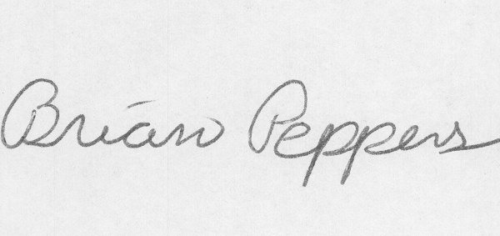
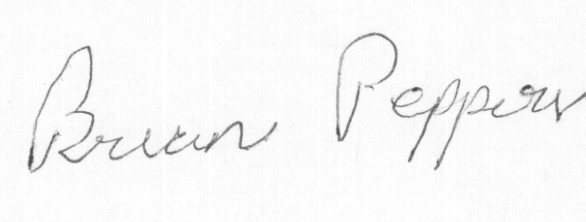
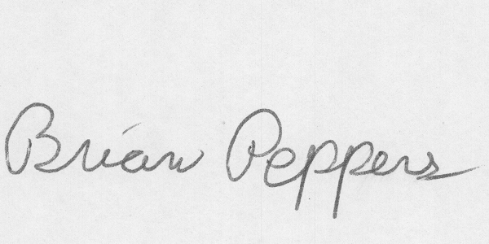
The Problem
Forgery
Genuine
Notes:
Insert a map of your country.

Slide 3
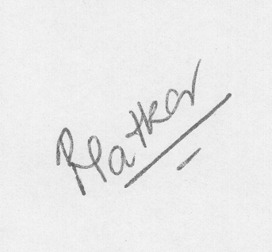
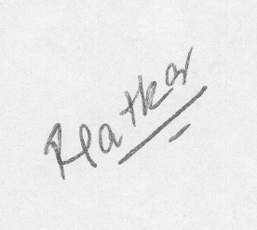
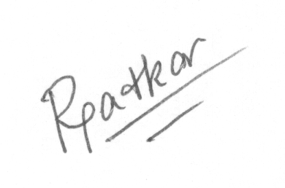
The Problem
Genuine
Forgery
Notes:
Insert a map of your country.

Slide 4
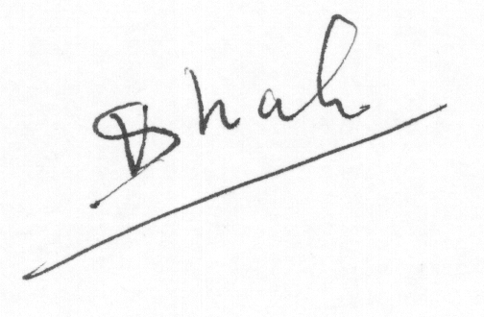
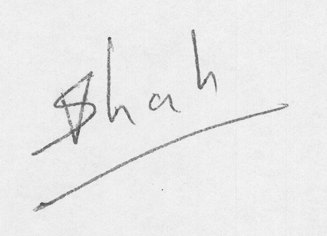
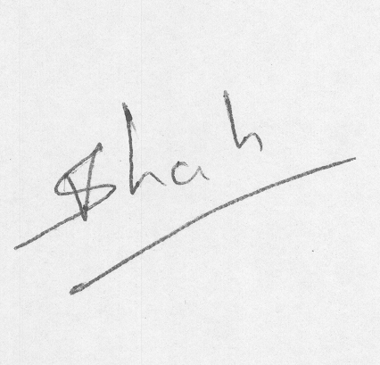
The Problem
Notes:
Insert a map of your country.

Slide 5
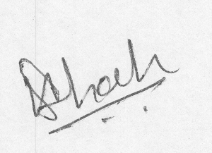
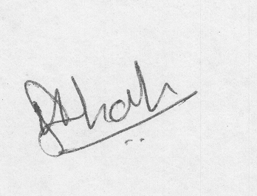
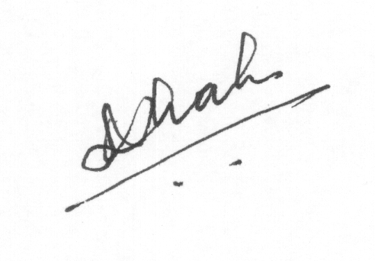
The Problem
Notes:
Insert a map of your country.

Slide 6
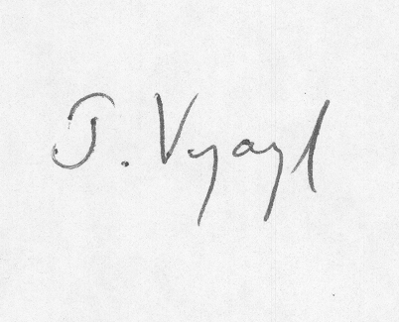
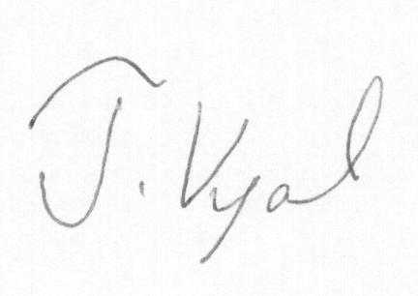
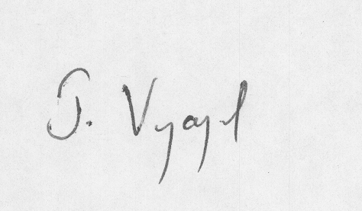
The Problem
Notes:
Insert a map of your country.

Slide 7
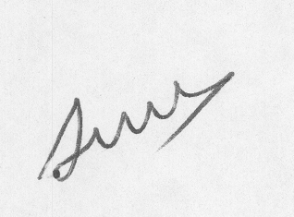
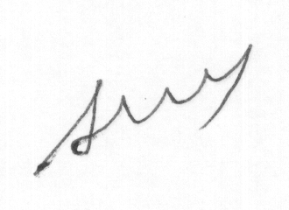
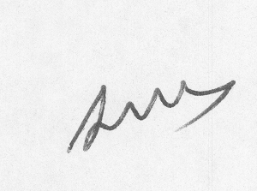
The Problem
Notes:
Insert a map of your country.

Slide 8
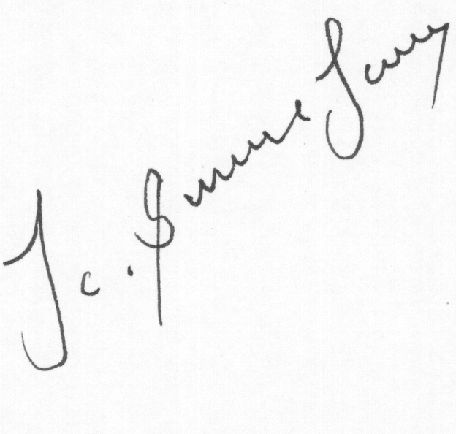
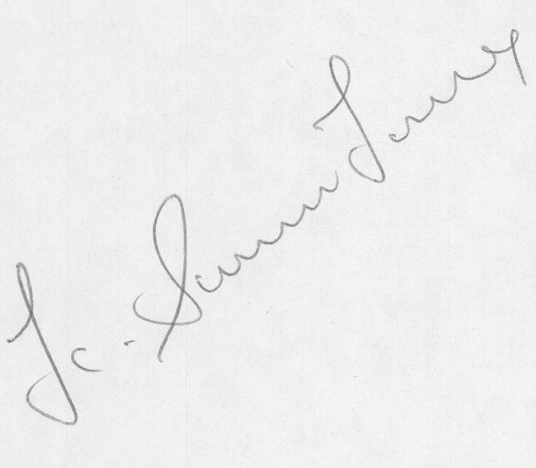
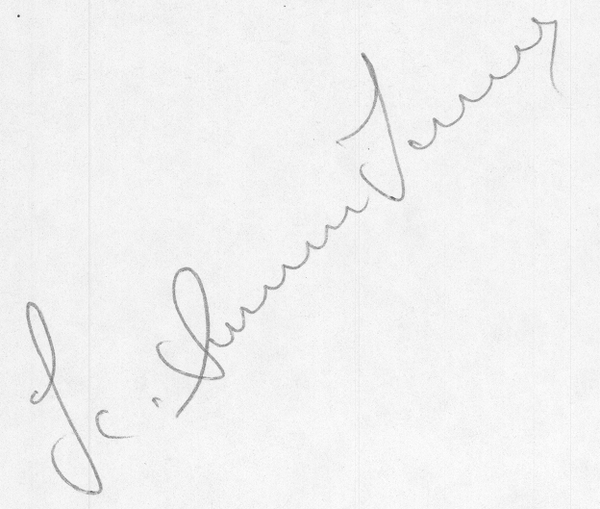
The Problem
Notes:
Insert a map of your country.

Slide 9
“Analysis of handwritten documents from the viewpoint of determining
the writer has great bearing on the criminal justice system.” Lives depend on it...

Slide 10
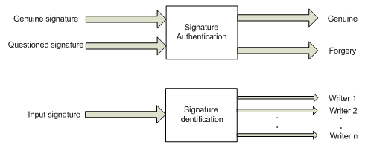
The Problem
Offline signature verification in the Forensic Signature Verification domain.
The task of identifying whether a signature is genuine or forged given a genuine copy of the signature.
Notes:
Insert a map of your country.

Slide 11
Conclusion
Supervised learning techniques using “Macro Features” yields an accuracy of upto 97%.
Comparing features in the distance space provides a robust criteria for distinguishing between genuines & forgeries.

Slide 12
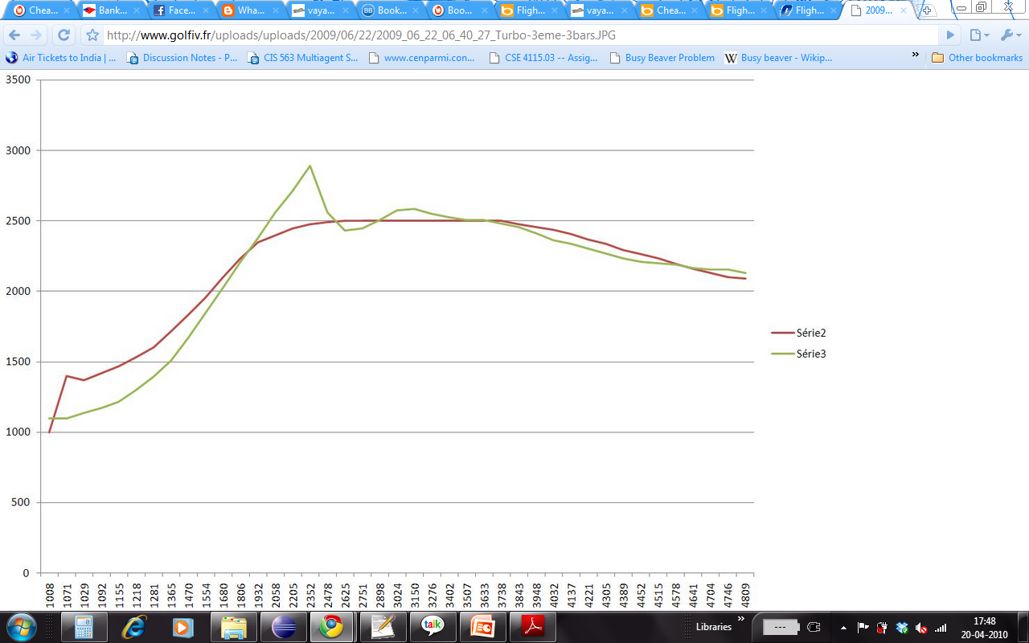
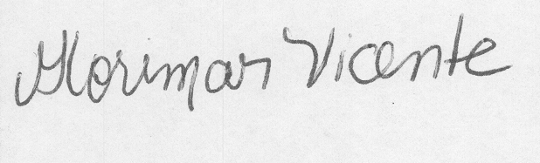
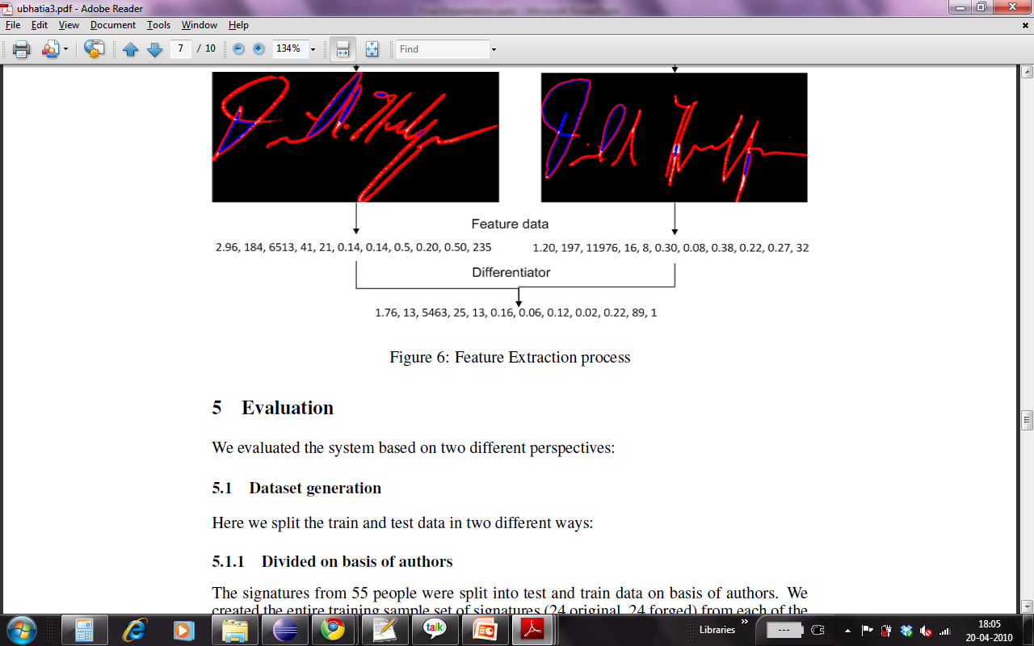
What makes this a hard problem
The ML Perspective
No Temporal Information.
Feature engineering.
Variance!!
Temporal signals – Pressure and speed
The Domain Perspective
The training of a document examiner involves years of learning.
People changes their writing styles.
External factors like pen choice, paper quality etc influence predictions.
Offline information processing
Notes:
Insert a picture illustrating a season in your country.

Slide 13
How we did it…
Walkthrough of the experiment…

Slide 14
Raw Image Set…
55 writers
24 genuines
24 forgeries
Images scanned at 300 DPI.

Slide 15
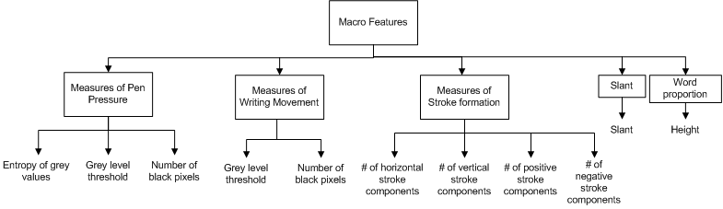
Computational Features…
We choose 11 Macro Features.
These features capture information globally over the image sample.

Slide 16
Computational Features…
They capture :
Measures of Pen Pressure
Measures of Writing Movement
Measures of Stroke Formation
Slant
Word Proportion

Slide 17
How we did it…
Raw Images
Preprocessing
Binarization
OTSU Thresholding
Bounding Box
Scaling
Feature Extraction
11 Macro Features
Classification

Slide 18
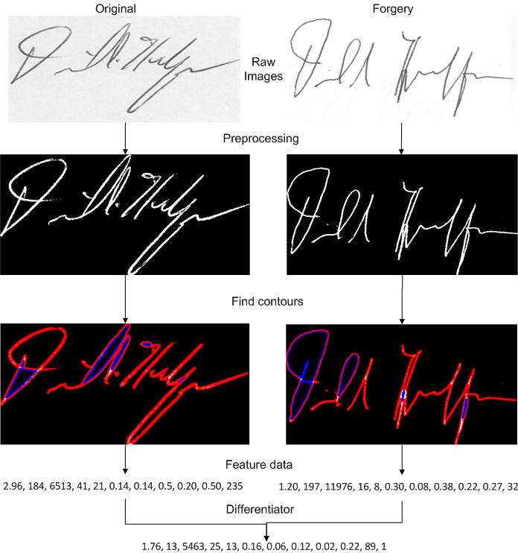
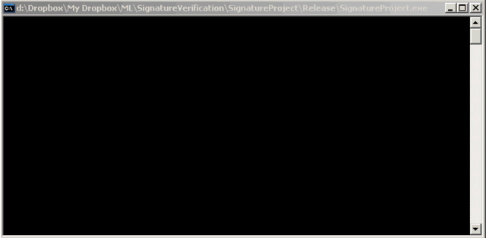
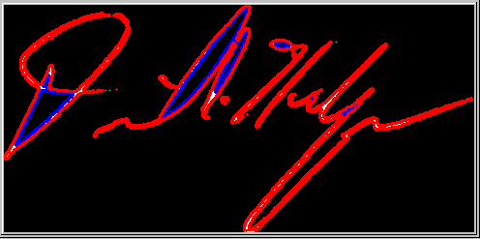
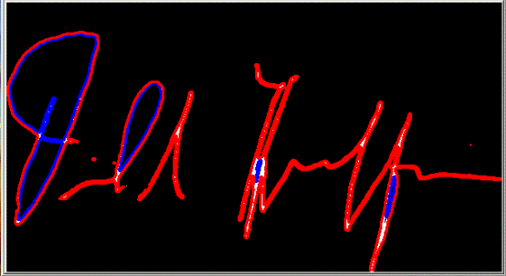
How we did it…

Slide 19
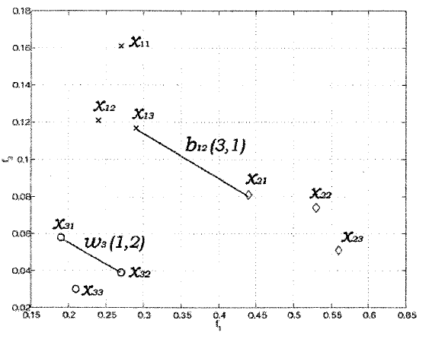
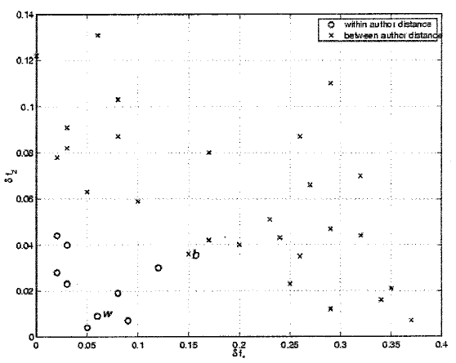
Transformation from feature space to distance space
Feature Space
Distance Space
Notes:
Insert a picture illustrating a season in your country.

Slide 20
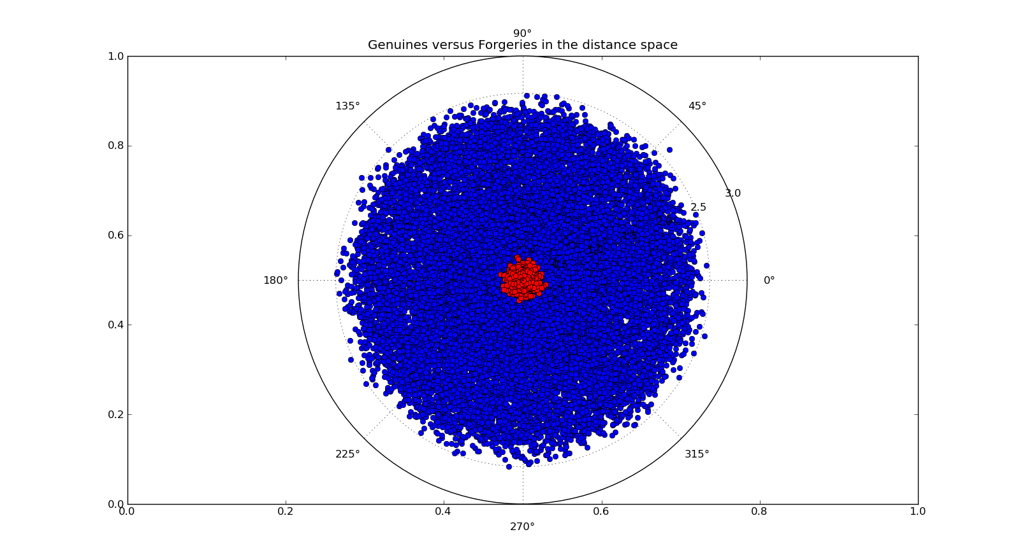
Differences captured by our model (In distance space)
Notes:
Insert a picture illustrating a season in your country.

Slide 21
Experimental setup
Scenario 1
Training set = 12 original, 12 forged from each of the 55 writers.
Testing set = 12 original, 12 forged of each of the 55 writers.
Scenario 2
Training set = 24 original, 24 forged from each of the 30 writers.
Testing set = 24 original, 24 forged for each of the remaining 25 writers.
Notes:
Insert a picture illustrating a season in your country.

Slide 22
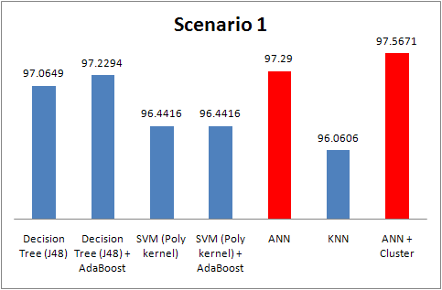
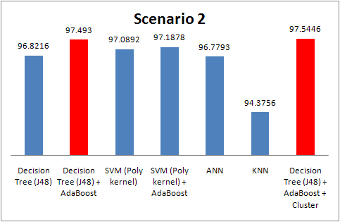
Results
“Interesting Observation: re-using clustering information boosted accuracy”
Notes:
Clustering and Boosting

Slide 23
Experimental setup
Scenario 3
We tested averages of the genuine sets.
Although they were correctly detected, we got ~4% false positives.
Scenario 4
We tested our models on an entirely new image-set obtained from ICFHR. (~80.81% accuracy for ANN)
(almost 5 times higher resolution)
Notes:
Insert a picture illustrating a season in your country.

Slide 24
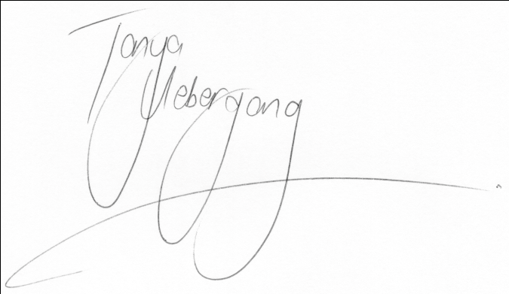
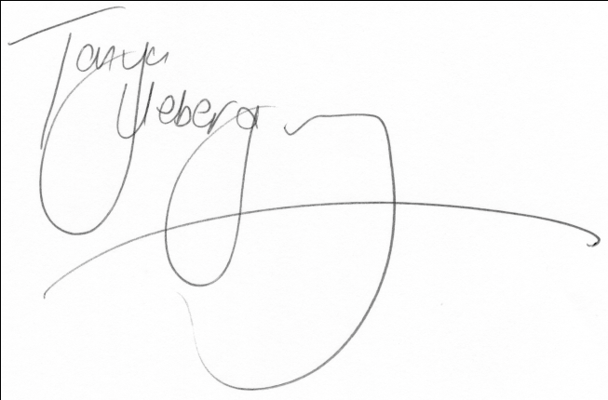
Reviews
Comparisons
New Datasets
We have obtained a new image-set and will be receiving more images from the ICFHR committee.
Explaining keywords like chaincodes and zernike moments.
Example of system failure.

Slide 25
Comparison to other techniques

Slide 26
Take aways…
Factors like image resolution, DPI etc affect information capture and thus influence accuracy.
Writer’s own variance plays a very important role.
Feature engineering is a very crucial component of applied machine learning.
Designing test cases is tricky

Slide 27
Take aways…
Know thy domain…

Slide 28
Future Work
1. Extracting other features like GSC <Gradient, Structure, Concavity>.
2. Incorporating approaches like DTW which simulate temporal-like information capture.
3. Testing our system on signatures written in different languages.
4. To train our model on the higher resolution images.
5. Explore models like HMMs etc.
Notes:
Insert a picture illustrating a season in your country.

